Slide 1
The Exiles - Nehemiah
Nehemiah 1 v 4 – 2 v 8

Slide 2
Nehemiah 1 v 4 – 2 v 8
[4] As soon as I heard these words I sat down and wept and mourned for days, and I continued fasting and praying before the God of heaven. [5] And I said, “O Lord God of heaven, the great and awesome God who keeps covenant and steadfast love with those who love him and keep his commandments, [6] let your ear be attentive and your eyes open, to hear the prayer of your servant that I now pray before you day and night for the people of Israel your servants, confessing the sins of the people of Israel, which we have sinned against you. Even I and my father’s house have sinned.

Slide 3
[7] We have acted very corruptly against you and have not kept the commandments, the statutes, and the rules that you commanded your servant Moses. [8] Remember the word that you commanded your servant Moses, saying, ‘If you are unfaithful, I will scatter you among the peoples, [9] but if you return to me and keep my commandments and do them, though your outcasts are in the uttermost parts of heaven, from there I will gather them and bring them to the place that I have chosen, to make my name dwell there.’

Slide 4
[10] They are your servants and your people, whom you have redeemed by your great power and by your strong hand. [11] O Lord, let your ear be attentive to the prayer of your servant, and to the prayer of your servants who delight to fear your name, and give success to your servant today, and grant him mercy in the sight of this man.” Now I was cupbearer to the king.

Slide 5
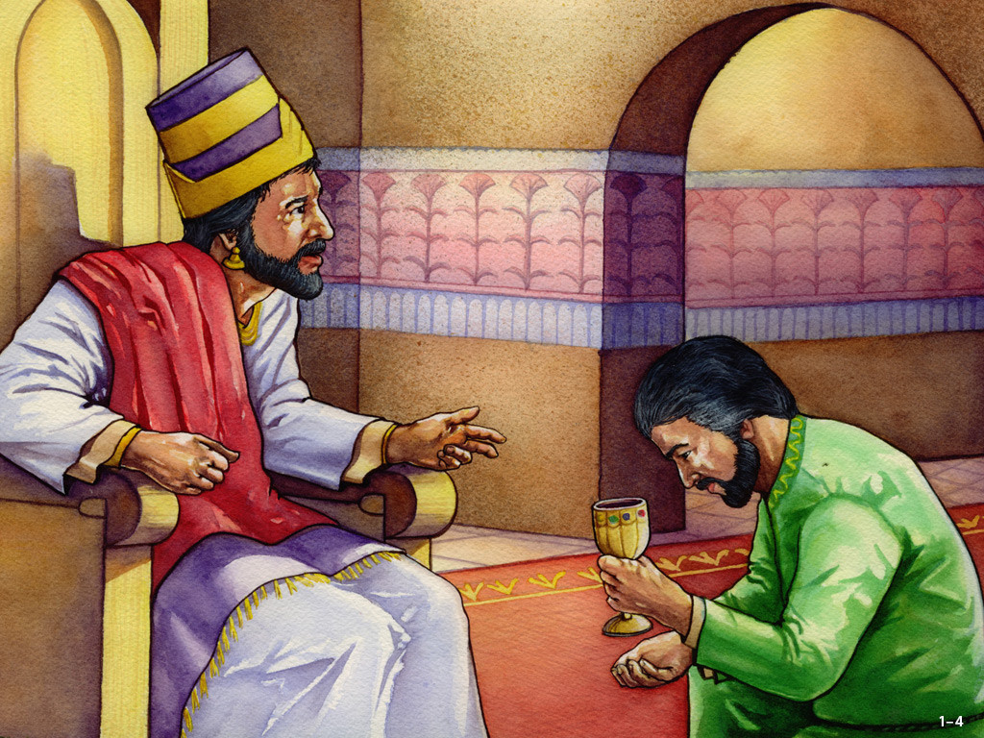
Cupbearer to the king
Tasting the wine for poison
Serving the wine at the royal table
Could exert political influence
High authority, high pay
Dangerous

Slide 6
Psalm 42:1-3, 11
[1] As a deer pants for flowing streams, so pants my soul for you, O God. [2] My soul thirsts for God, for the living God. When shall I come and appear before God? [3] My tears have been my food day and night, while they say to me all the day long, “Where is your God?”
[11] Why are you cast down, O my soul, and why are you in turmoil within me? Hope in God; for I shall again praise him, my salvation and my God.

Slide 7
Nehemiah
Repentance
Remember
Redemption
Favour

Slide 8
Repentance

Slide 9
Luke 7:36-38, 47
[36] One of the Pharisees asked him to eat with him, and he went into the Pharisee’s house and reclined at table. [37] And behold, a woman of the city, who was a sinner, when she learned that he was reclining at table in the Pharisee’s house, brought an alabaster flask of ointment, [38] and standing behind him at his feet, weeping, she began to wet his feet with her tears and wiped them with the hair of her head and kissed his feet and anointed them with the ointment.
[47] Therefore I tell you, her sins, which are many, are forgiven—for she loved much. But he who is forgiven little, loves little.”

Slide 10
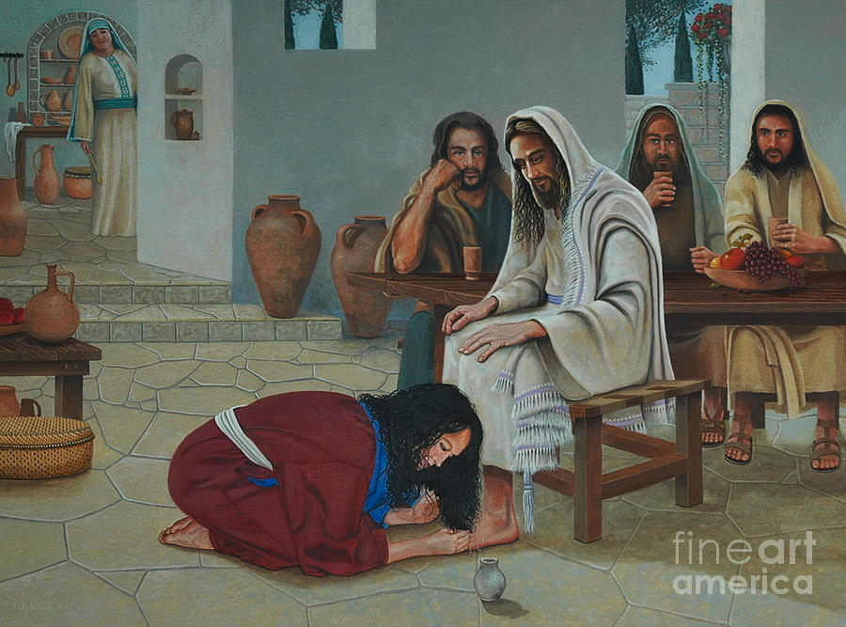

Slide 11
2 Corinthians 7:9-10
[9] As it is, I rejoice, not because you were grieved, but because you were grieved into repenting. For you felt a godly grief, so that you suffered no loss through us. [10] For godly grief produces a repentance that leads to salvation without regret, whereas worldly grief produces death.

Slide 12
Remember

Slide 13
1 Peter 2:9-10
[9] But you are a chosen race, a royal priesthood, a holy nation, a people for his own possession, that you may proclaim the excellencies of him who called you out of darkness into his marvelous light. [10] Once you were not a people, but now you are God’s people; once you had not received mercy, but now you have received mercy.

Slide 14
Matthew 5:13-16
[13] “You are the salt of the earth, but if salt has lost its taste, how shall its saltiness be restored? It is no longer good for anything except to be thrown out and trampled under people’s feet. [14] “You are the light of the world. A city set on a hill cannot be hidden. [15] Nor do people light a lamp and put it under a basket, but on a stand, and it gives light to all in the house. [16] In the same way, let your light shine before others, so that they may see your good works and give glory to your Father who is in heaven.

Slide 15
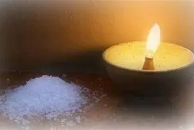

Slide 16
Matthew 13:33 ESV
[33] He told them another parable. “The kingdom of heaven is like leaven that a woman took and hid in three measures of flour, till it was all leavened.”

Slide 17
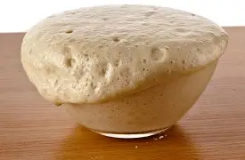

Slide 18
Redemption

Slide 19
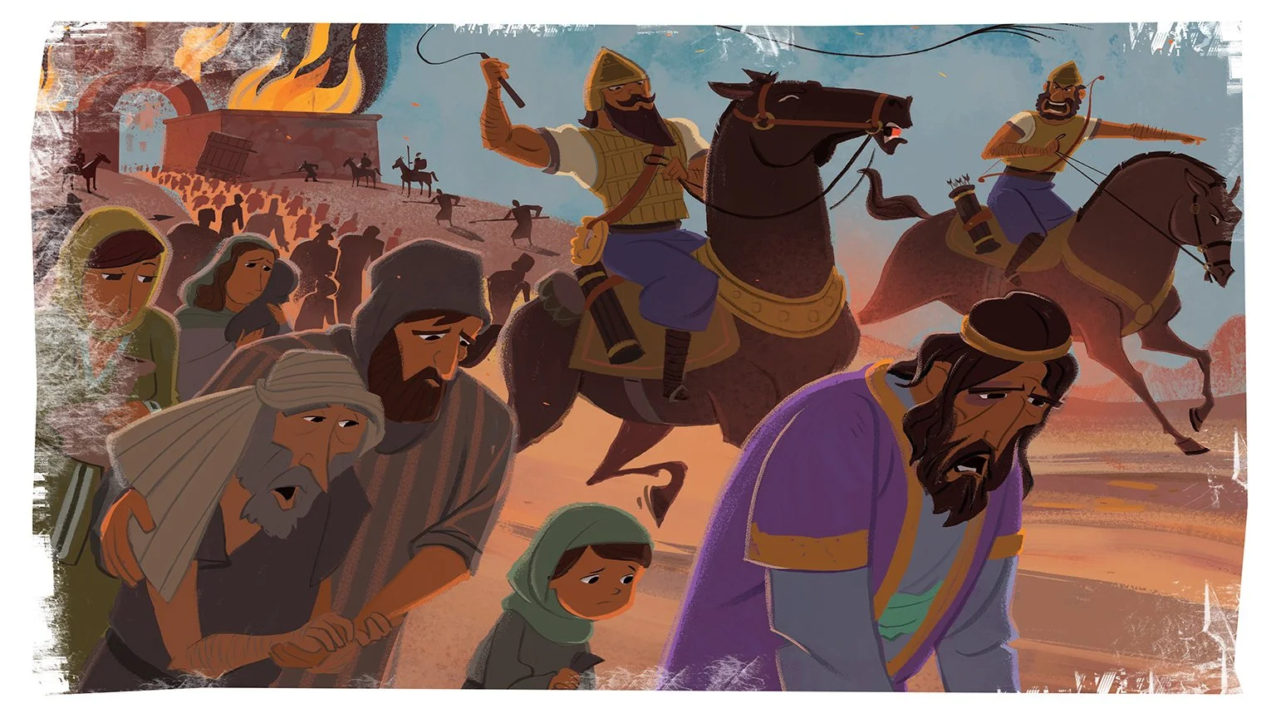
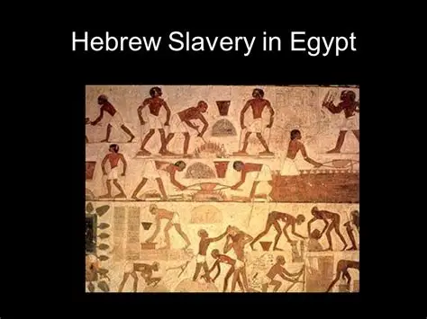

Slide 20
Galatians 4:4-7
[4] But when the fullness of time had come, God sent forth his Son, born of woman, born under the law, [5] to redeem those who were under the law, so that we might receive adoption as sons. [6] And because you are sons, God has sent the Spirit of his Son into our hearts, crying, “Abba! Father!” [7] So you are no longer a slave, but a son, and if a son, then an heir through God

Slide 21
[1] In the month of Nisan, in the twentieth year of King Artaxerxes, when wine was before him, I took up the wine and gave it to the king. Now I had not been sad in his presence. [2] And the king said to me, “Why is your face sad, seeing you are not sick? This is nothing but sadness of the heart.” Then I was very much afraid. [3] I said to the king, “Let the king live forever! Why should not my face be sad, when the city, the place of my fathers’ graves, lies in ruins, and its gates have been destroyed by fire?” [4] Then the king said to me, “What are you requesting?” So I prayed to the God of heaven.

Slide 22
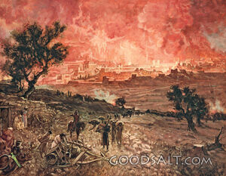

Slide 23
[5] And I said to the king, “If it pleases the king, and if your servant has found favor in your sight, that you send me to Judah, to the city of my fathers’ graves, that I may rebuild it.” [6] And the king said to me (the queen sitting beside him), “How long will you be gone, and when will you return?” So it pleased the king to send me when I had given him a time. [7] And I said to the king, “If it pleases the king, let letters be given me to the governors of the province Beyond the River, that they may let me pass through until I come to Judah,

Slide 24
[8] and a letter to Asaph, the keeper of the king’s forest, that he may give me timber to make beams for the gates of the fortress of the temple, and for the wall of the city, and for the house that I shall occupy.” And the king granted me what I asked, for the good hand of my God was upon me.

Slide 25
Psalm 2:1-3, 10-12
[1] Why do the nations rage and the peoples plot in vain? [2] The kings of the earth set themselves, and the rulers take counsel together, against the Lord and against his Anointed, saying, [3] “Let us burst their bonds apart and cast away their cords from us.”
[10] Now therefore, O kings, be wise; be warned, O rulers of the earth. [11] Serve the Lord with fear, and rejoice with trembling. [12] Kiss the Son, lest he be angry, and you perish in the way, for his wrath is quickly kindled. Blessed are all who take refuge in him.

Slide 26
Nehemiah
Repentance
Remember
Redemption
Favour

